Slide 1
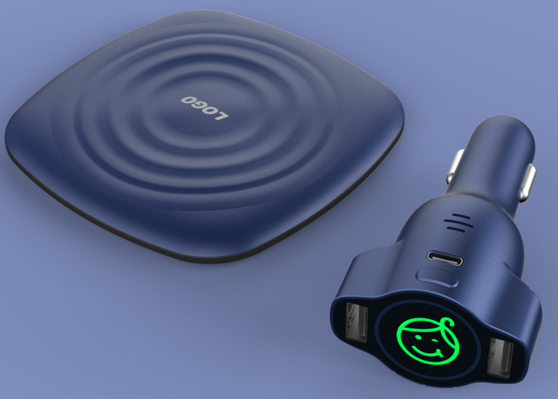
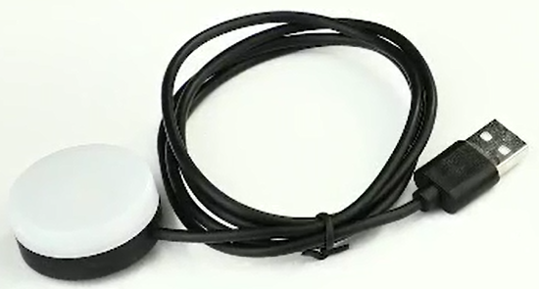
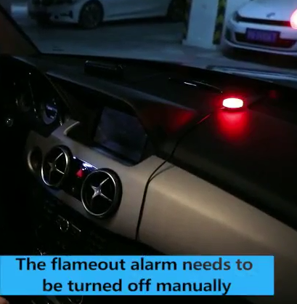
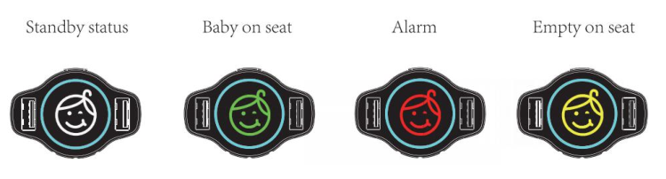
Car Baby Seat Alarm
Our Baby Seat Alarm is a wireless device with a small sensing pad which placed under the baby seat cushion.
It's a alarm reminder system which over exhausted parents of infants to take baby out of the car. Few hour forgot will be regret forever.
1) Prevent child from hot car deaths.
2) Visual and audible alarm.
3) Wireless transmission, keeping tidy in vehicle.
4) Can be warning at least 2 min. after flame out.
5) With LED light alarm, can we warning at least 15 min. (option)
6) With dual car charger function. QC3.0 fast charging and 5V/2.4A charging.
Support type-c output connect: 5/2.4A
Package contents:
1. Display
2. Sensor pad
3. User Manual
4. Gift box
Alarm Car charger with pad Price: USD9.5
LED waring light: USD1.8

Slide 2
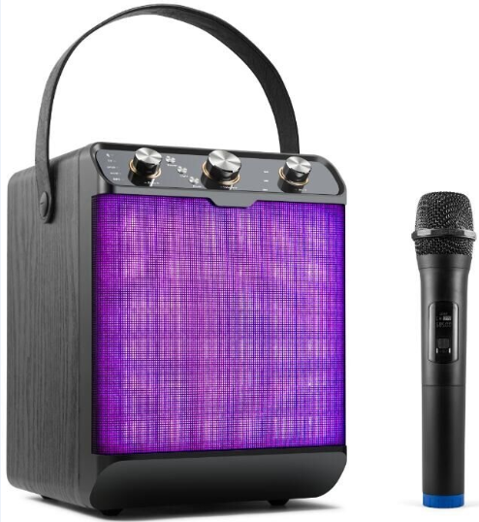
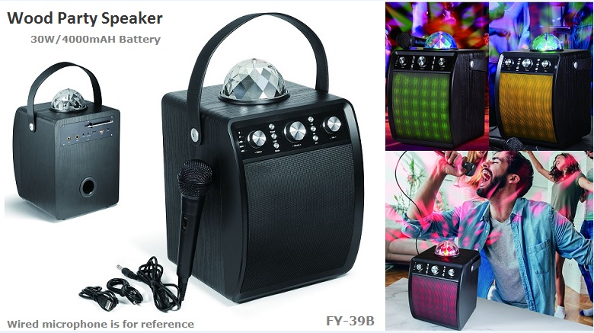
Wooden Disco LED Speaker

Slide 3
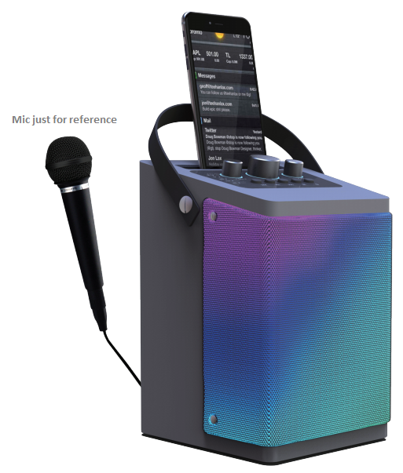
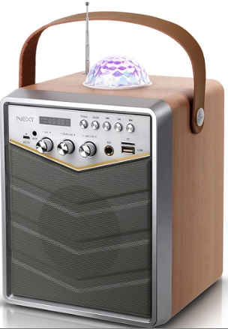
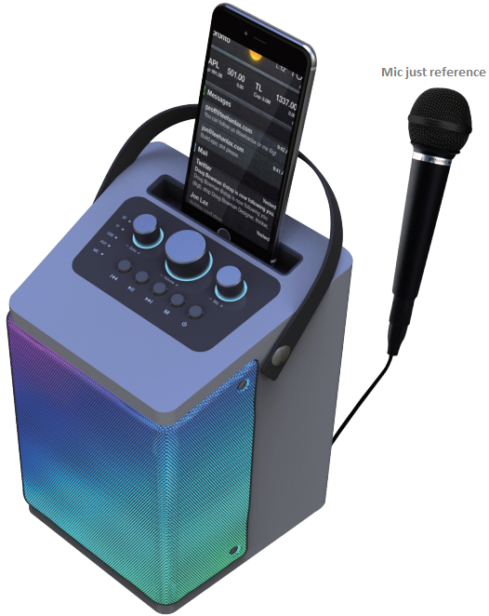
Wooden Disco LED Speaker

Slide 4
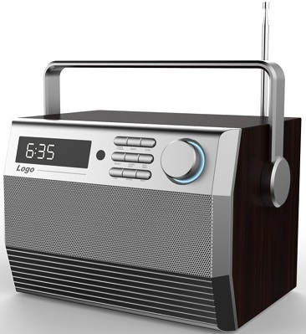
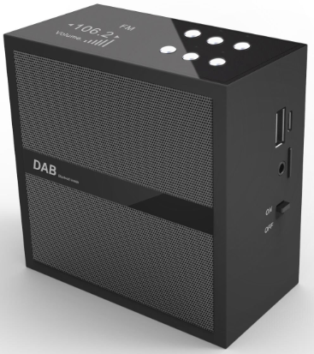
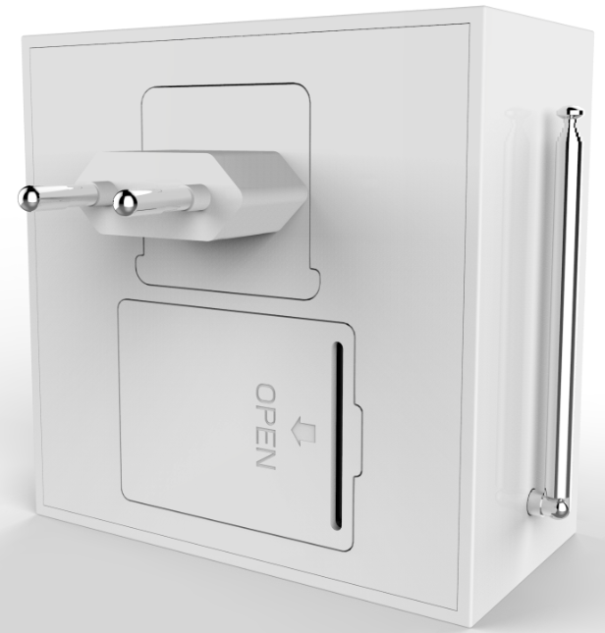
DAB/DAB+ Wooden Speaker (DAB function is optional)

Slide 5
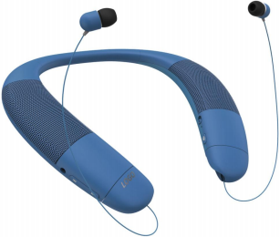
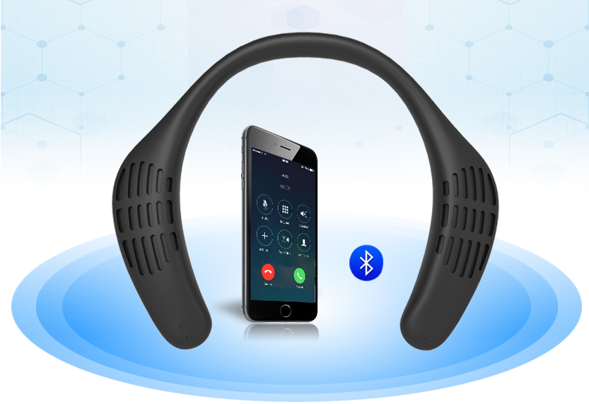
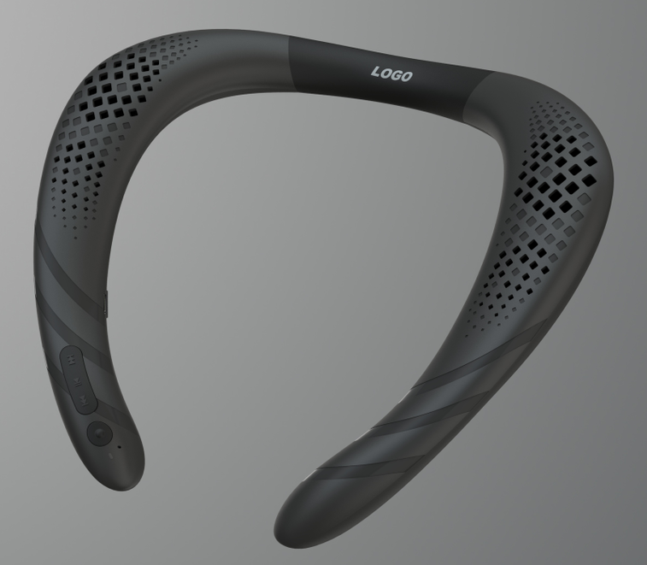
Neckband speaker

Slide 6
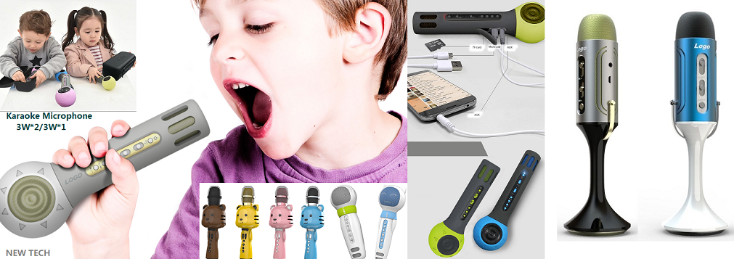
Bluetooth Karaoke Microphone For Kids

Slide 7
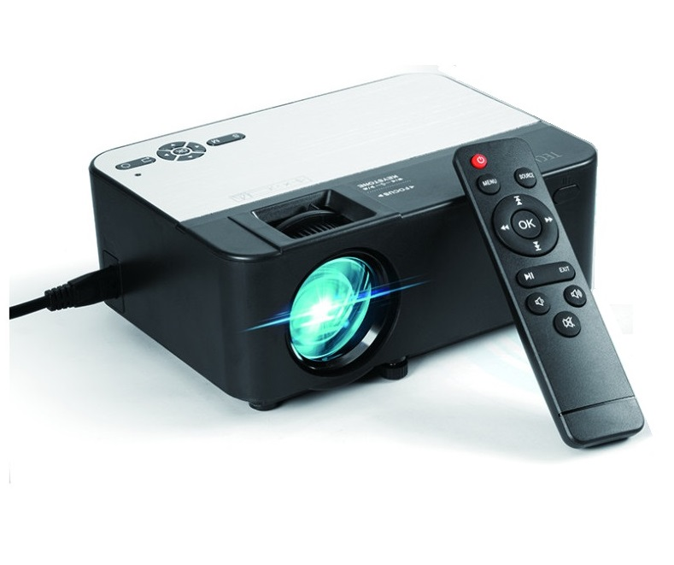
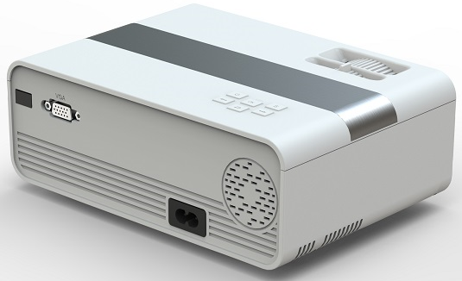
BEAMER with HDMI certificate
480P
720P

Slide 8
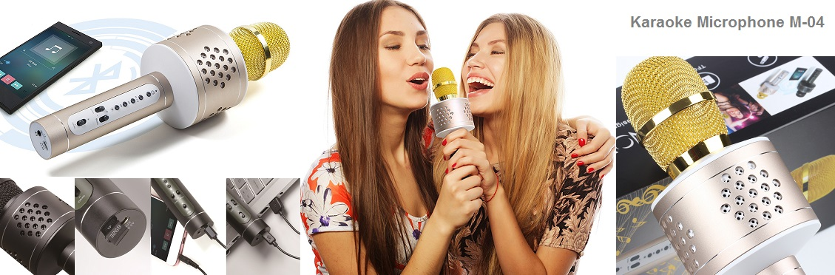
Bluetooth Karaoke Microphone (Alumium Silica Housing)

Slide 9
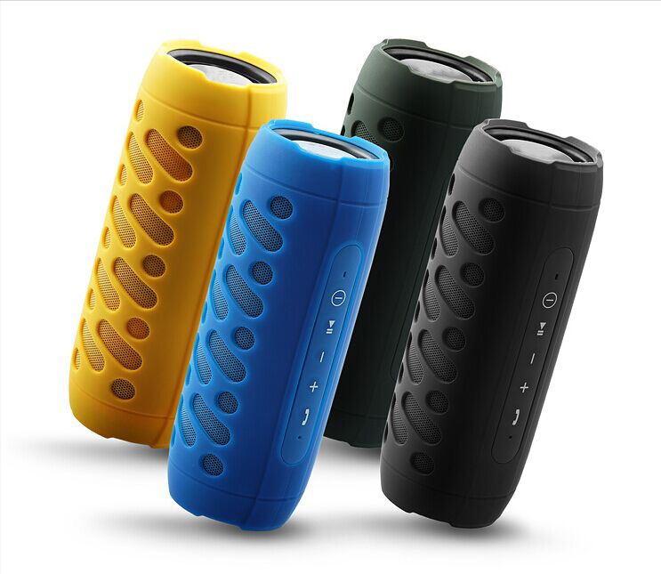
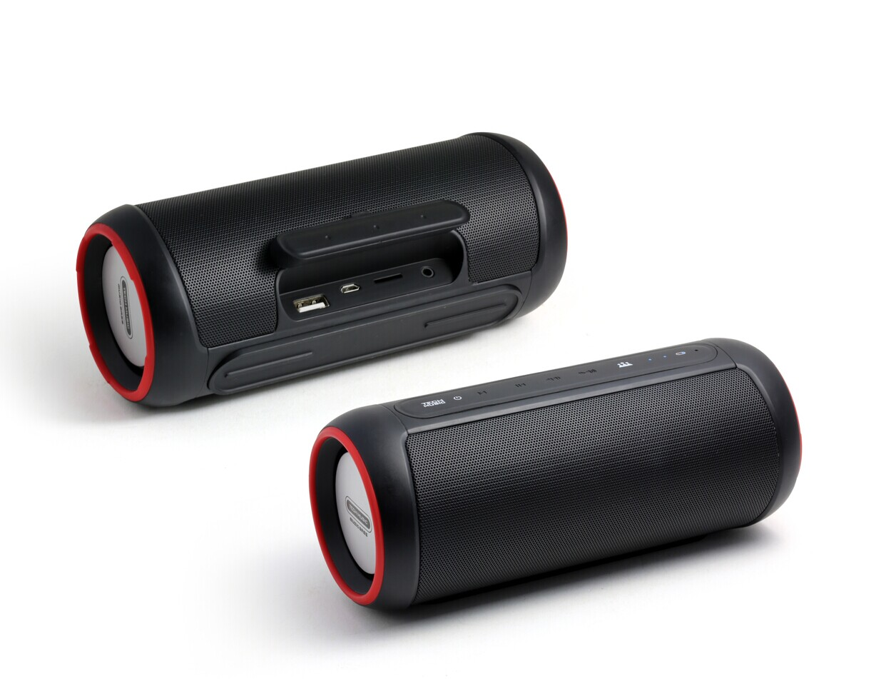
IPX5 Water Resistance Stereo Bluetooth Speaker

Slide 10
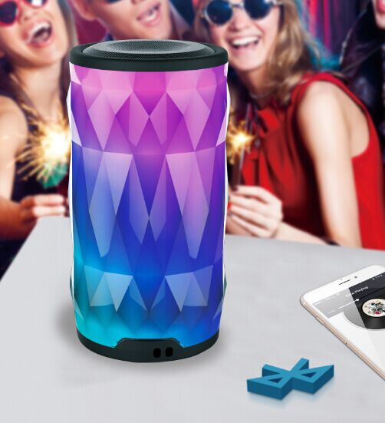
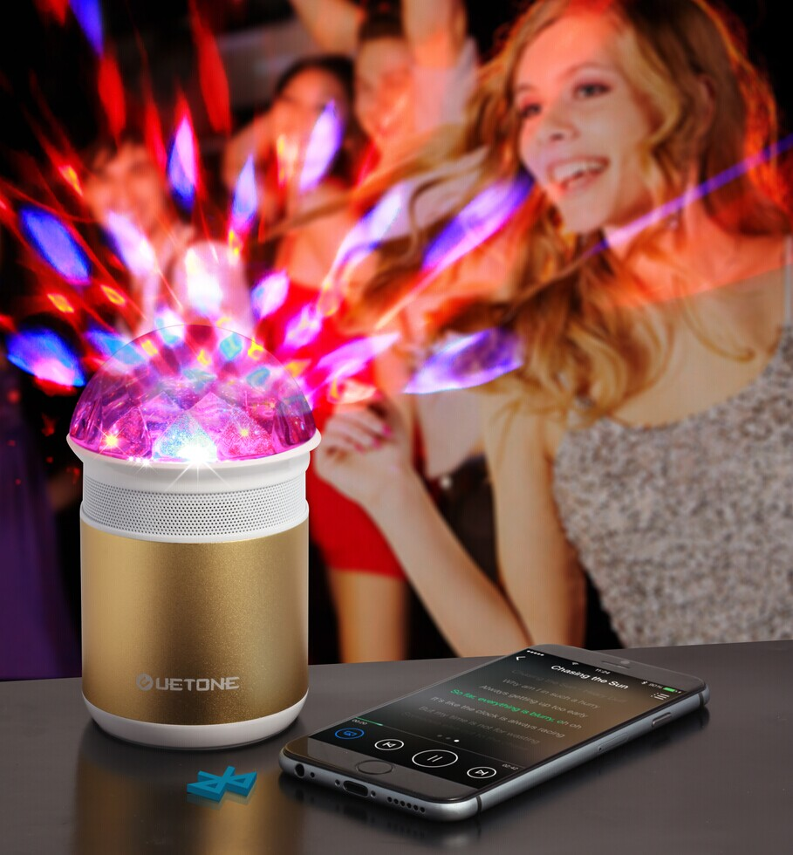
LED Bluetooth Speaker

Slide 11
Above designs are all our private with patent

